Slide 1
ETL Project
Tom Babjak
Will Cutrone
Fleming Brathwaite
Edyson Katuuo

Slide 2
Datasets
“Life Expectancy (WHO)”
Contains info on life expectancy per country
“Who eats the food we grow”
Contains info on food availability by country
“Country Socioeconomic Status Scores: 1880-2010”
Contains info on Socioeconomic status by country
All found on kaggle.com

Slide 3
Goal
To be able to have a table where we can see the following information for each country: life expectancy, food availability and socioeconomic status
Enable users to perform more complex queries of this table to identify trends or get specific info on each country

Slide 4
Process (extraction)
Began with 3 csvs
life_expectancy.csv
FAO.csv
GLOB.SES.csv
Each csv was then loaded into jupyter notebook and converted into a dataframe
After making the dataframes, dataframes were then cleaned to just show desired columns and were adjusted so that each data frame had one country per row
Dataframes were also filtered to look at years 2000 and 2010 since these were years that were present in all 3 datasets

Slide 5
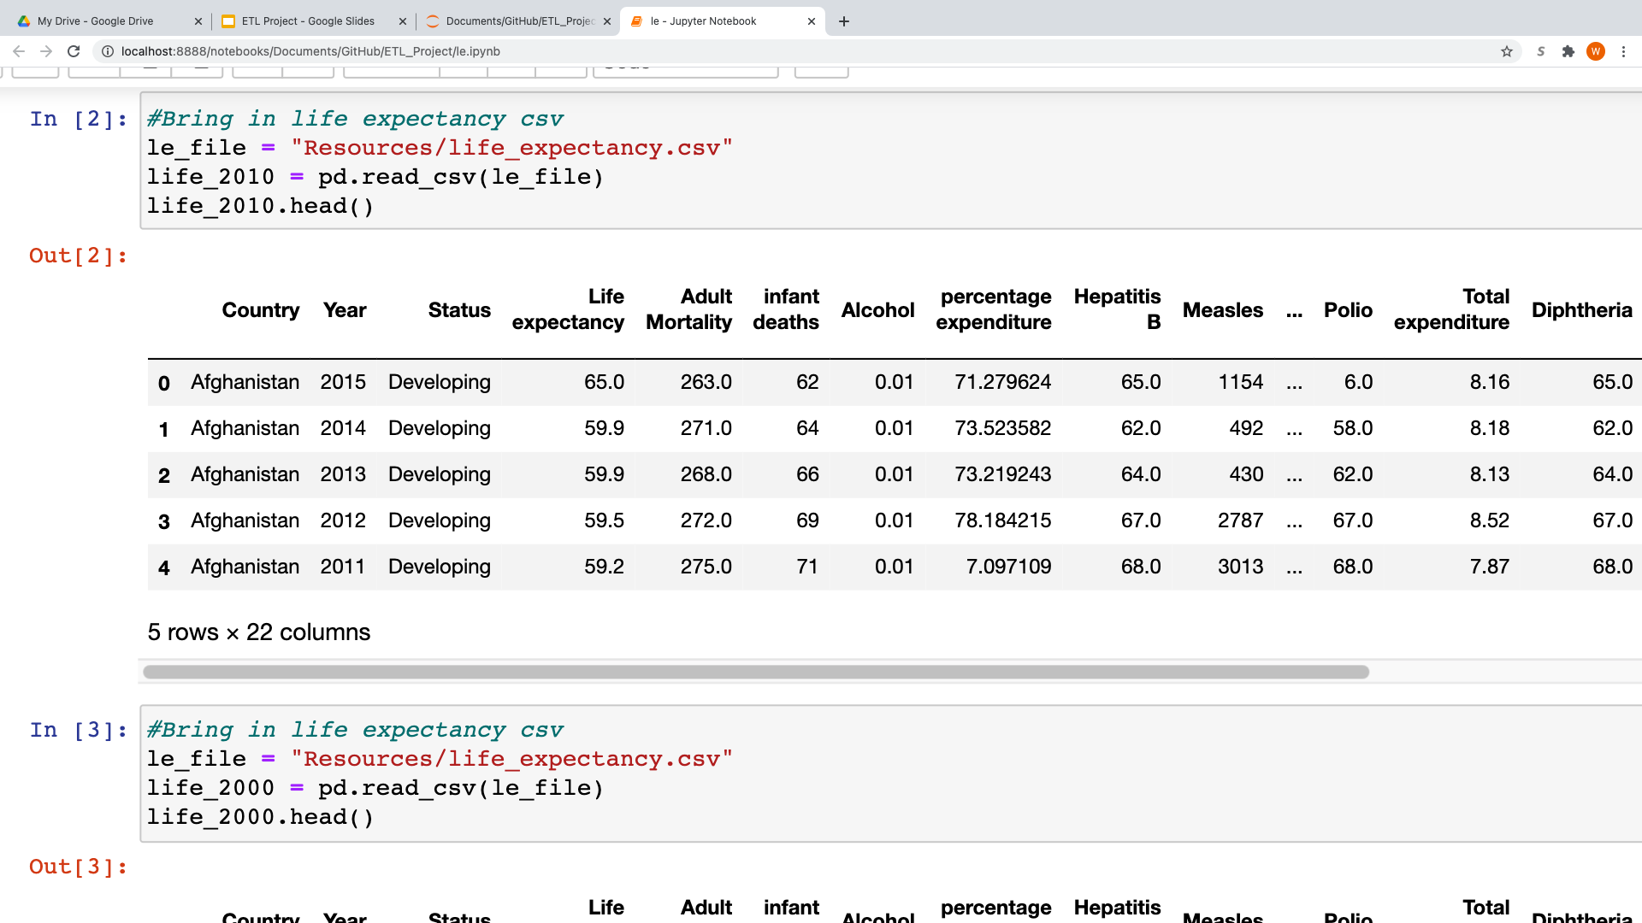
Process LE (transform)

Slide 6
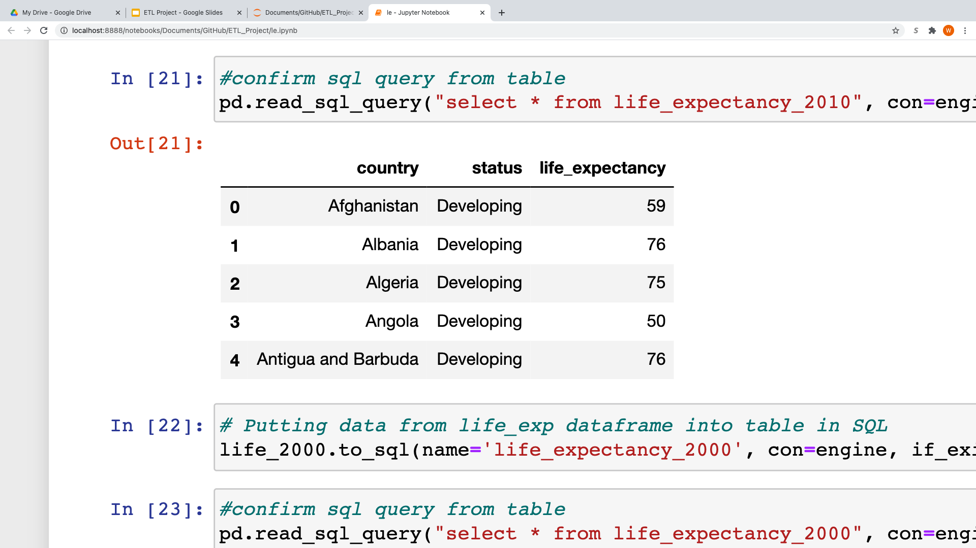
Process LE(transform)
Notes:
Show the columns that you want
Do on for 2000 to 2010
Clean the dataframe so that there is a unique country in every row

Slide 7
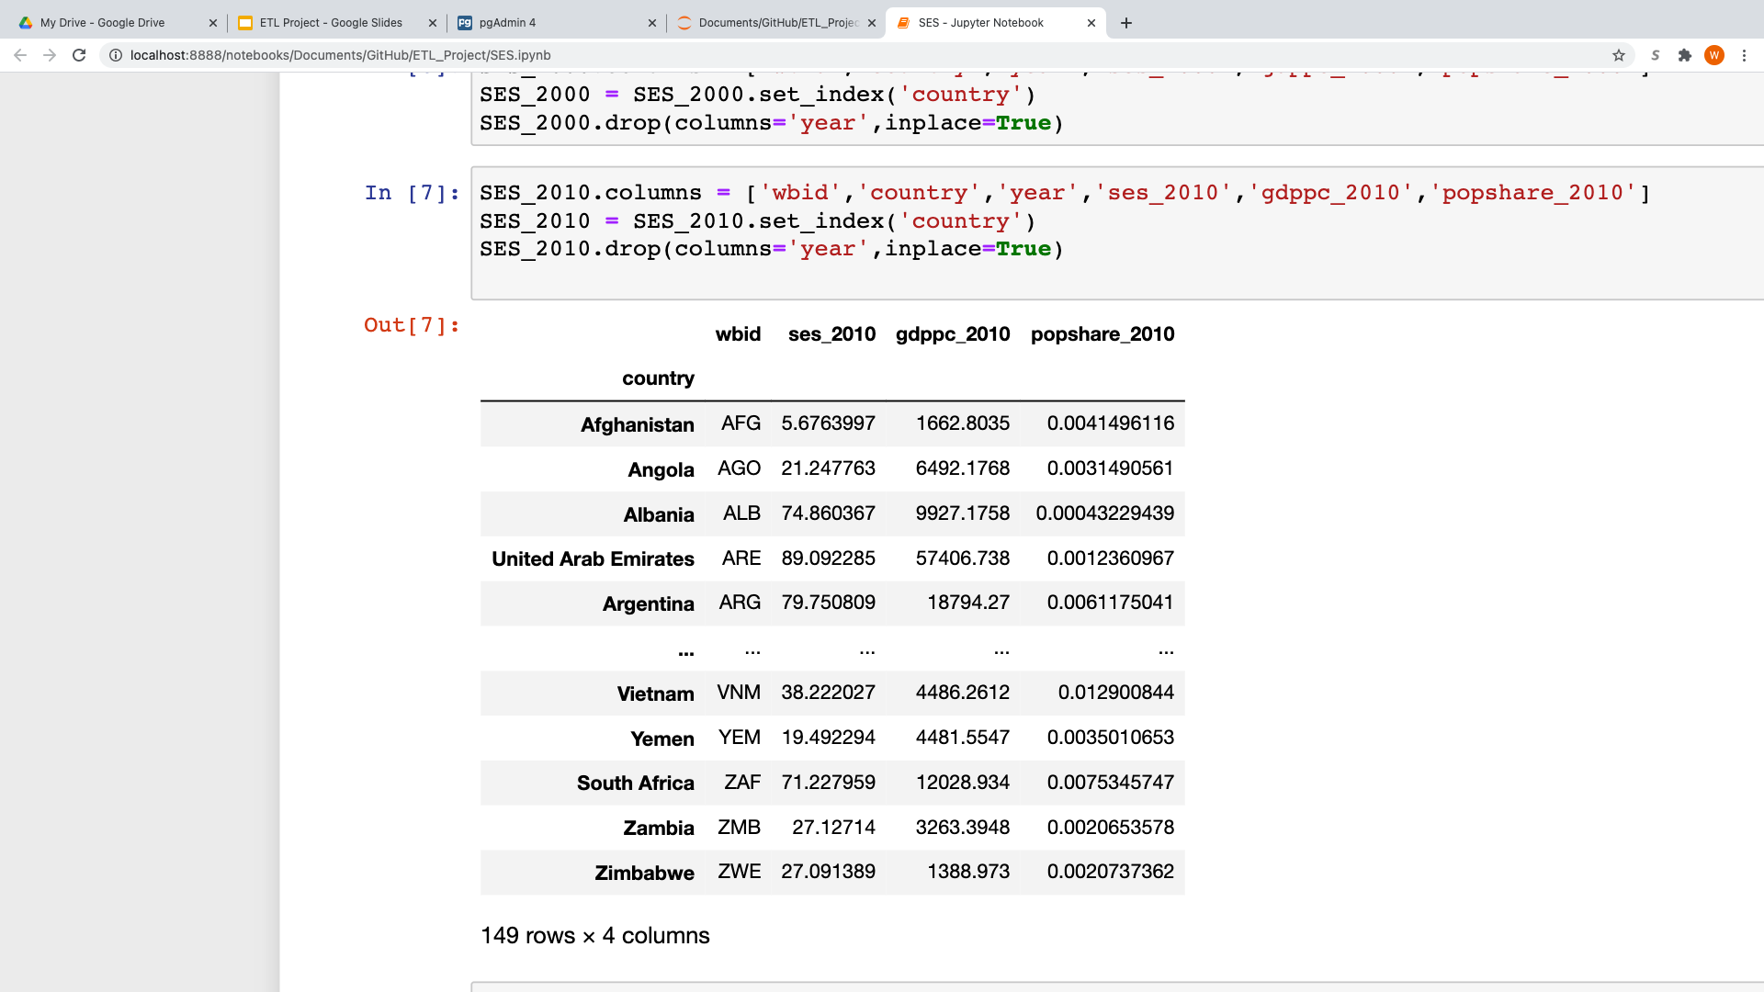
Process SES (transform)

Slide 8
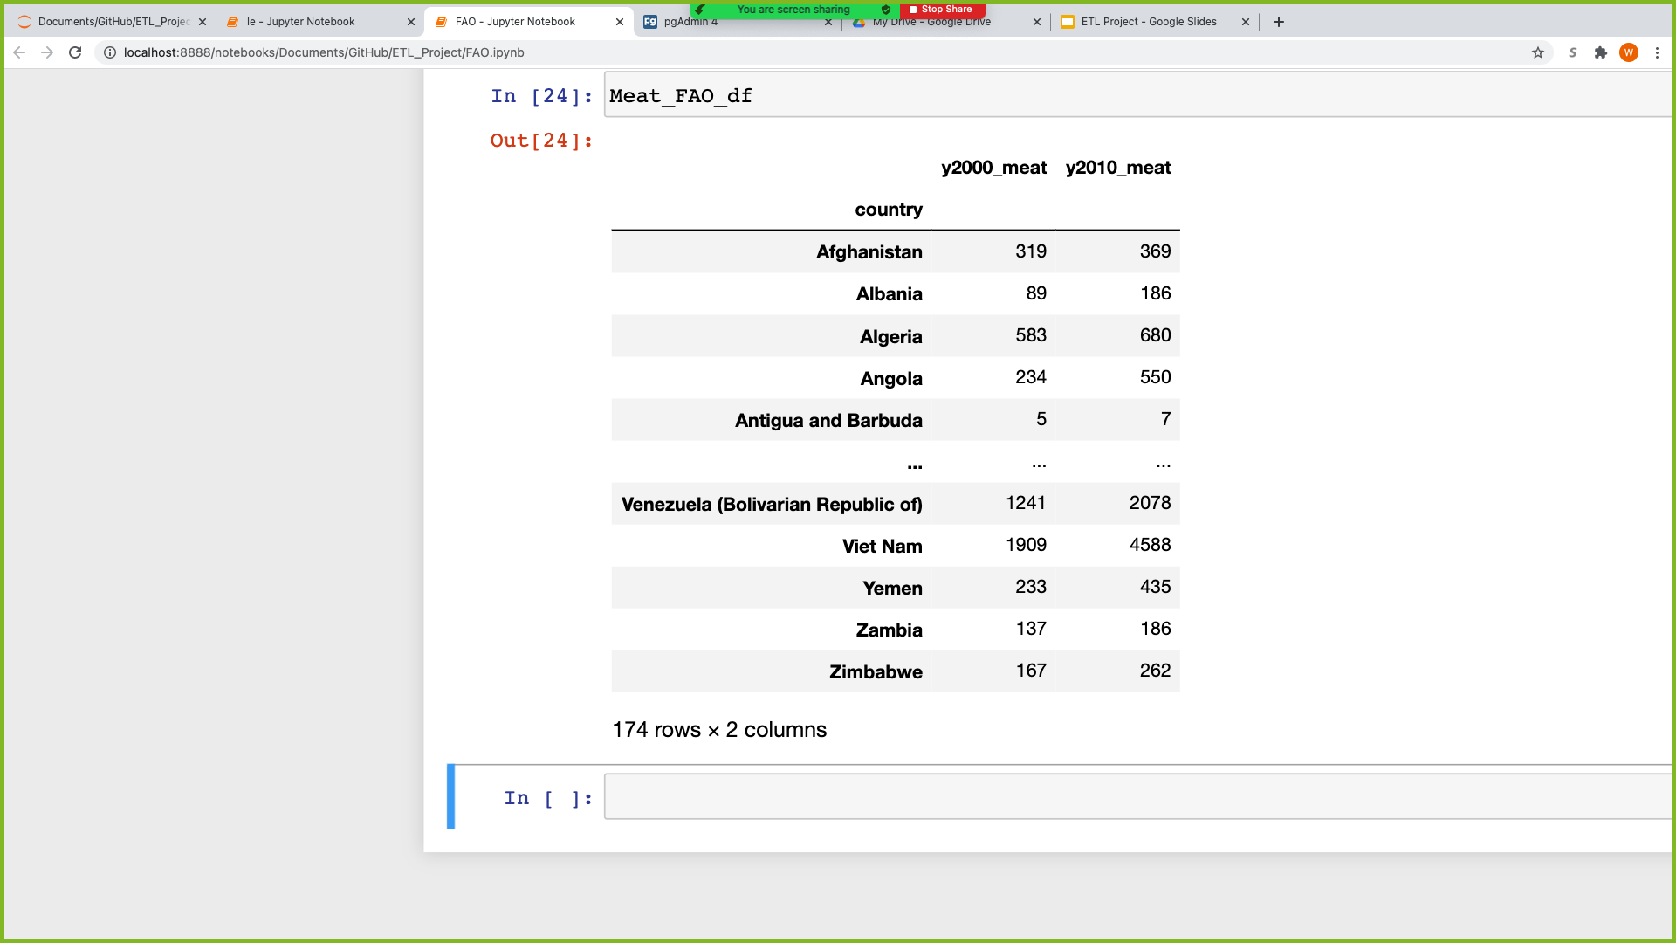
Process FAO (transform)

Slide 9
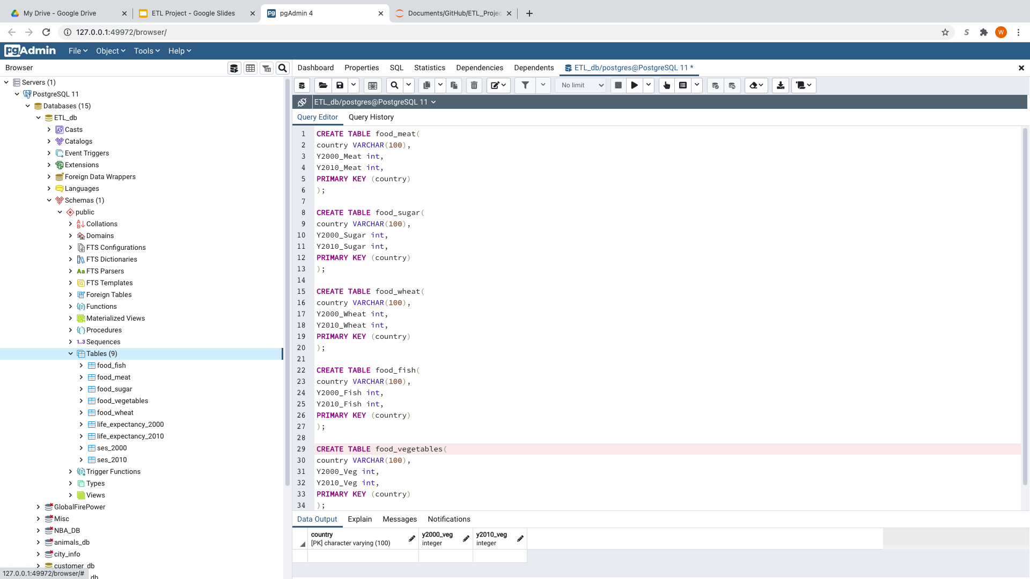
Process (Load)
Empty tables were created in pgadmin that data from dataframes would eventually be loaded into

Slide 10
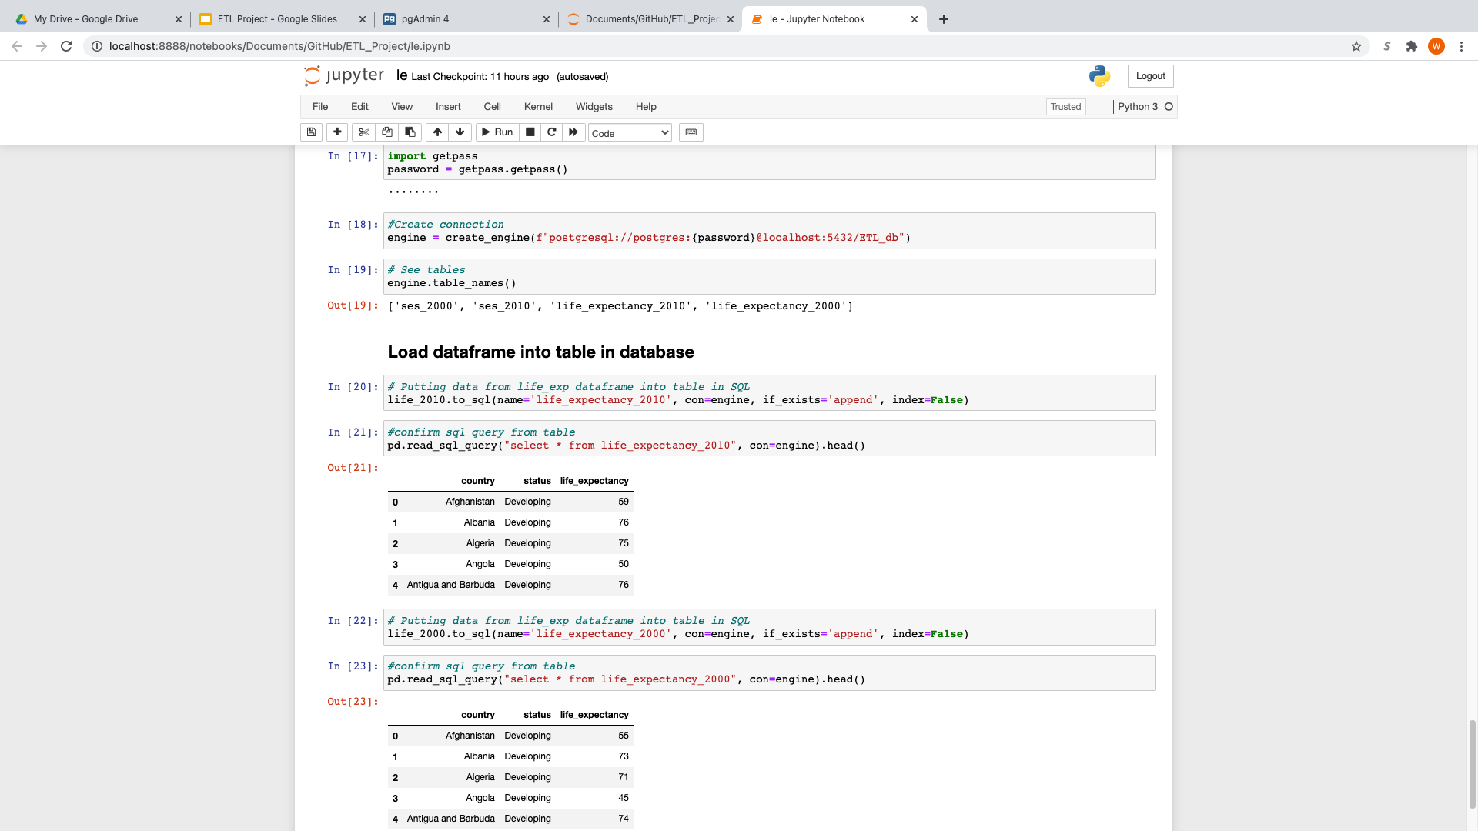
Process (load)
Information from pandas dataframes was loaded into corresponding tables on pgadmin

Slide 11
Process (Load)
Once tables were populated, tables from all three datasets could be joined on country
In each table all US rows where changed to “United States of America”

Slide 12
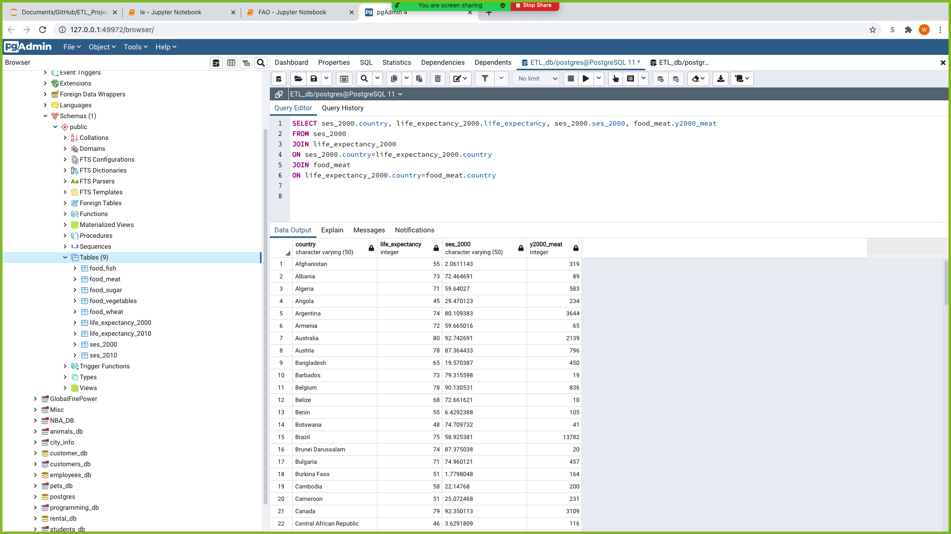

Slide 13
Questions?

